Slide 1
Anomaly diagnosis method- Pre-Study
15.09.2023

Slide 2
Content
Scenario
Key Idea
Model Workflow(Training and Inference)
Method
CNN+LSTM
TCN

Slide 3


Scenario
Process Stage
Technical Issue
RCA_Stage1
RCA_Stage2
Anomaly diagnosis will be applied here
Alarm report
observation from custmors
Deviation detection
Which parameter is anomaly
Identifies underlying causes of faults.
User Behaviour
Common Database
Inference on EDDA
Inference on EDDA
EDDA
EDDA
Choose the timeframe when the issue occurred.
Get the abnormal parameter
Get the root cause of the issue(Probability)
Eg:
Fuel nozzle clogging : 49%
Fuel gas composition change : 21 %
Fuel gas valve malfunction : 2%
Eg:
Issue happened between 12/09/2023 9:00 am to 10:00 am
Select data between12/09/2023 9:00 am to 10:00 am
Eg:
BPT is diagnose anormal by EDDA

Slide 4
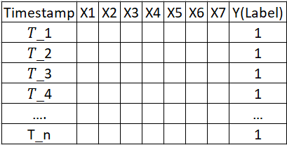
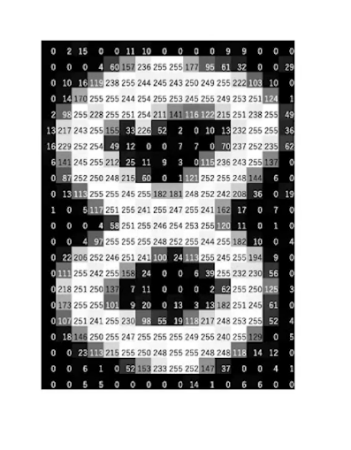
Key Idea
Problem Define : Determine the corresponding root cause (output) for a given abnormal input
Aim : Build Time Series Classification model , each parameters has own classification model
Key idea: Each time series sequence is transformed into a 2D image-like representation.
Pattern Recognition: By using a 2D image-like representation , we can uncover whether there are specific patterns within the time series that share the same root cause
Temporal Relationships: study the relationships and patterns between different variables over time
Each abnormal case is a grey scale picture

Slide 5
Model Workflow
Aim to build Time Series Classification model : Each parameters has own classification model
Data preparing and pre-process
Feature Engineering:
Extract domain-specific attributes, following traditional detection criteria; expert guidance is essential.
E.g. BPT is abnormal parameters,{X1,X2…X7} is variable related with BPT
interval for the occurrence of the issue

Slide 6
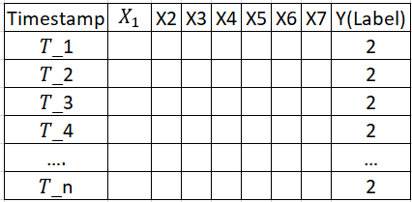
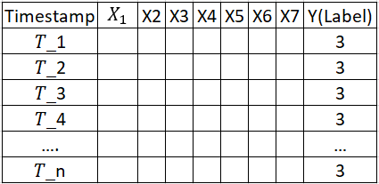
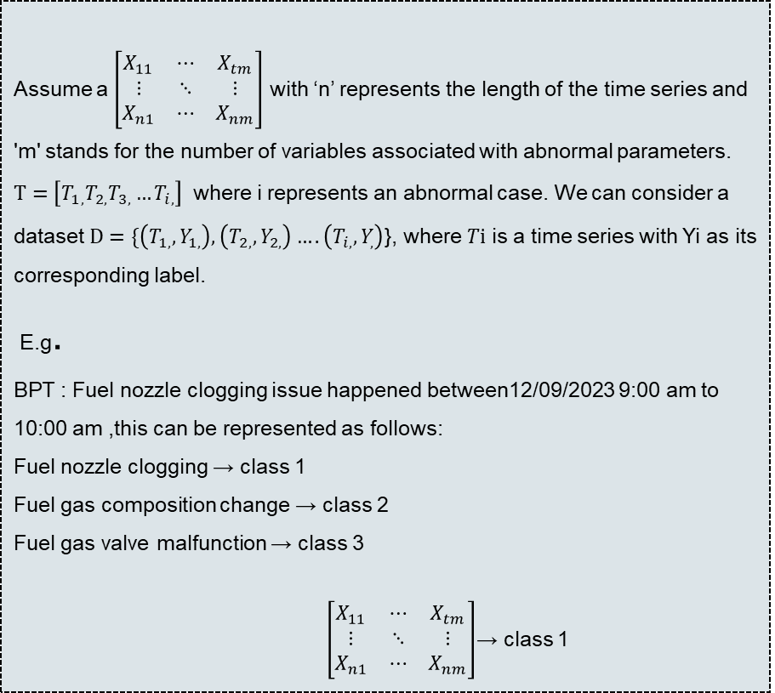
Model Workflow
Aim to build Time Series Classification model : Each parameters has own classification model
Data preparing and pre-process
Assume a $\left[\begin{matrix}X_{11} & ⋯ & X_{tm} \\ ⋮ & ⋱ & ⋮ \\ X_{n1} & ⋯ & X_{nm}\end{matrix}\right]$ with ‘n’ represents the length of the time series and 'm' stands for the number of variables associated with abnormal parameters.
$T=\left[T_{1,}T_{2,}T_{3,}…T_{i,}\right]$ where i represents an abnormal case. We can consider a dataset $D=\{\left(T_{1,},Y_{1,}\right),\left(T_{2,},Y_{2,}\right)….\left(T_{i,},Y_{,}\right)$}, where $Ti$ is a time series with Yi as its corresponding label.
E.g.
BPT : Fuel nozzle clogging issue happened between12/09/2023 9:00 am to 10:00 am ,this can be represented as follows:
Fuel nozzle clogging → class 1
Fuel gas composition change → class 2
Fuel gas valve malfunction → class 3
$\left[\begin{matrix}X_{11} & ⋯ & X_{tm} \\ ⋮ & ⋱ & ⋮ \\ X_{n1} & ⋯ & X_{nm}\end{matrix}\right]$→ class 1
Label data :
Supervised learning
each abnormal case can be represented as a two-dimensional matrix, and each matrix can be associated with a label
Label provide from experts
Normalization
12/09/2023 9:00
to
12/09/2023 10:00

Slide 7
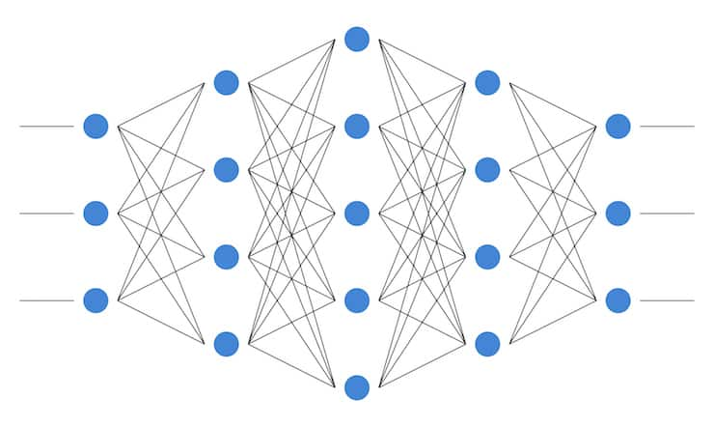

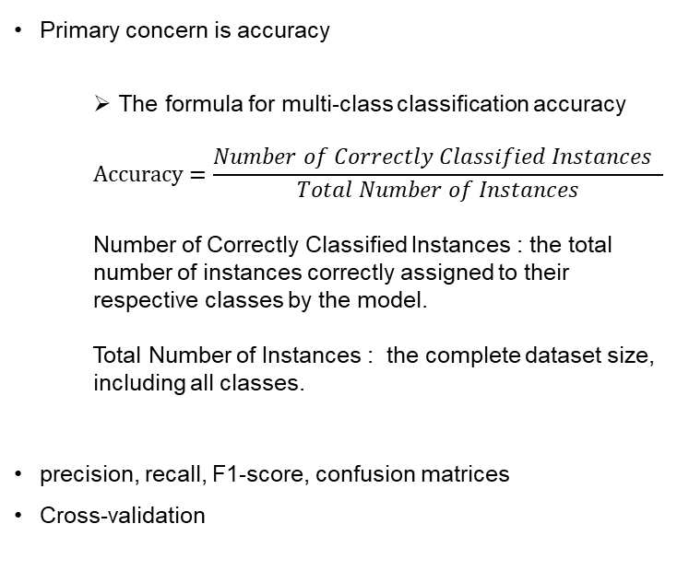


Model Workflow
Aim to build Time Series Classification model : Each parameters has own classification model
Data sampling
Model Training
Model Evaluate
Training unit : An abnormal case
Data balance or not
Balance : Random Sample. 7:3 or 8:2 to split training set and testing set
Unbalance : SMOTE
Method
CNN+LSTM
TCN
The model's output will consist of probabilities assigned to each class.
Primary concern is accuracy
The formula for multi-class classification accuracy
$$Accuracy=\frac{Number of Correctly Classified Instances }{Total Number of Instances}$$
Number of Correctly Classified Instances : the total number of instances correctly assigned to their respective classes by the model.
Total Number of Instances : the complete dataset size, including all classes.
precision, recall, F1-score, confusion matrices
Cross-validation
$$\left[\begin{matrix}X_{11} & ⋯ & X_{tm} \\ ⋮ & ⋱ & ⋮ \\ X_{n1} & ⋯ & X_{nm}\end{matrix}\right]$$
$$T_{1}$$
.
.
.
.
.
.
BPT fault dataset
$$\left[\begin{matrix}X_{11} & ⋯ & X_{tm} \\ ⋮ & ⋱ & ⋮ \\ X_{n1} & ⋯ & X_{nm}\end{matrix}\right]$$
$$T_{i}$$
Class 1 (Fuel nozzle clogging) : 49%
Class 2 (Fuel gas composition change) : 21 %
Class 3 (Fuel gas valve malfunction) : 2%

Slide 8
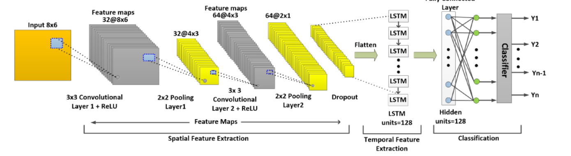
Method-CNN+LSTM
+
Feature Extraction with CNNs
LSTM for Sequential Learning
Long-term Recurrent Convolutional Networks for Visual Recognition and Description https://arxiv.org/pdf/1411.4389.pdf
CNN-LSTM Deep Learning Architecture for Computer Vision-based Modal Frequency Detectio
A Hybrid CNN-LSTM Based Approach for Anomaly Detection Systems in SDNs https://dl.acm.org/doi/fullHtml/10.1145/3465481.3469190

Slide 9
Method-TCN
The description of a Temporal Convolutional Network is based on the following paper:An Empirical Evaluation of Generic Convolutional and Recurrent Networks for Sequence Modeling https://arxiv.org/pdf/1803.01271.pdf
Architecture: 1D fully connected layers and convolutional layers. These convolutional layers utilize causal and dilated convolution
Causal Convolution:
Extract derived features from time series data
ensure that at any time t, the model is only using information from time t and earlier.
In practice, it's like applying a 1D convolutional layer, but with padding on the left, ensuring that the output at time t does not look into the future.
Dilated Convolution:
Receptive Field Size: As you move up the layers, convolution window size grows, thereby increasing the receptive field and reducing computation.
Residual Block: Each residual block contains
A causal convolution.
ReLU activation function.
A causal convolution.
ReLU activation function.
A skip connection that adds the input to the block to its output.
If the input and output dimensions don’t match, a 1x1 convolution is used to transform the input before adding.
Stacking Residual Blocks:
Multiple such residual blocks are stacked to increase the receptive field of the network.
The depth of TCN (i.e., the number of these stacked residual blocks) determines how far back in the input sequence model can effectively "see" or consider.
Output Layer:
After all the residual blocks, we can attach an output layer suitable for our task. For our sequence classification is the entire sequence gets a single label,the output might be a softmax distribution over classes for the entire sequence.

Slide 10
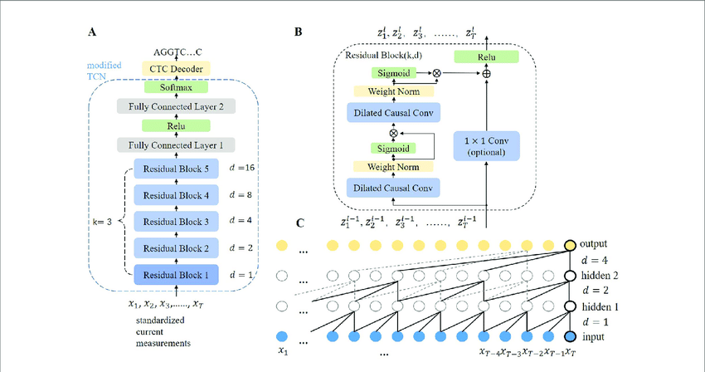
Method-TCN
The description of a Temporal Convolutional Network is based on the following paper:An Empirical Evaluation of Generic Convolutional and Recurrent Networks for Sequence Modeling https://arxiv.org/pdf/1803.01271.pdf
(B) Architecture of a residual block
(A) Overall architecture of the TCN-based model.

Slide 11
Method- Implemented
CNN+LSTM
Convolutional layers (using tf.keras.layers.Conv1D for time series)
LSTM layers (using tf.keras.layers.LSTM).
can stack these layers sequentially in a model
TCN
TensorFlow does support 1D convolution which is essential for TCN, it doesn't provide an out-of-the-box TCN layer. However, there are third-party implementations, such as the keras-tcn package
Can be implemented using TensorFlow

